Slide 1

Network Design for
Hotel Management

Slide 2

Submitted By:
Priyanshu
Aman Hatwar
Sarhan
Nafih

Slide 3
All the Departments should have computers installed.
Every department have own printers
The computers in all the Departments should have internet connection.
Every Floor have free wi-fi access.
Every department should communicate each other.
Project Objectives

Slide 4
Contents
03
02
01
Requirement Analysis
Network Design Strategy
Hotel
Infrastructure
06
04
05
Network
Diagram
Network
Setup
Recommended Products

Slide 5
Hotel Infrastructure
The hotel has 3 floors with 9 Departments
01
02
First Floor have 3 Departments
03
Second Floor 3 Departments.
04
Third Floor 2 Departments.
05
Access point in every floor

Slide 6
Hotel Room
The strategy is to create a network that has highest quality and standards.
We can connect all the department on the hotel directly with the router but its cost estimation is higher as compared to a switch.
We can also connect the PCs with a hub but it is inefficient because its speed of data transmitting is very unequal to a switch.
So, we’ll use switch to connect the PCs and printers using Fast Ethernet cables with the switch which will be further be connected to Routers.
By using different access point in every floor it will enhance the speed of Wi-Fi.
We’ll implement Ethernet connection to provide internet for the guest so as to avoid complexity of Wi-Fi login id and password.
Network Design
Strategy

Slide 7


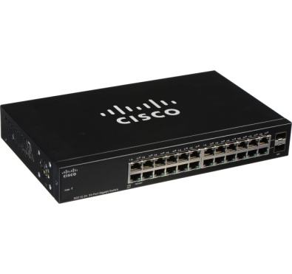
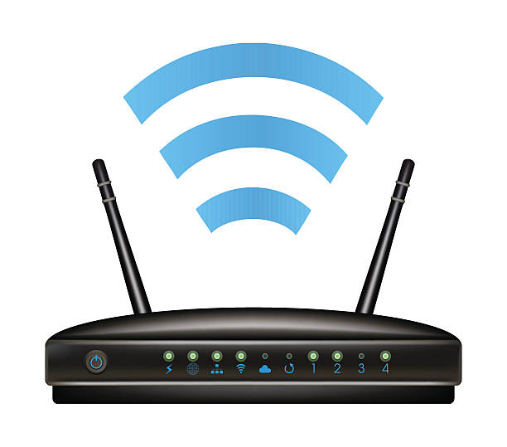
Requirement Analysis
PC
Switch
Router
Access point
The 3 - star hotel support 3 computers in first two floor and two in last floor.
The hotel has 3 floor in the hotel management. So, 8 PCs would be required.
All the less than 3 PCs of the floor are connected to one switch.
We will need 1 switch to connect 3– PCs of hotel management.
So, total 3 switches would be required.
As per our requirement we’ll require 3 Routers
Each Router will be connected to each switches in the floor.
Every Router connects each other
To provide wireless internet access in every floor we’ll require 3 Access Point
Wi-Fi repeaters are easier to set up and configure
Ethernet Cables

Slide 8
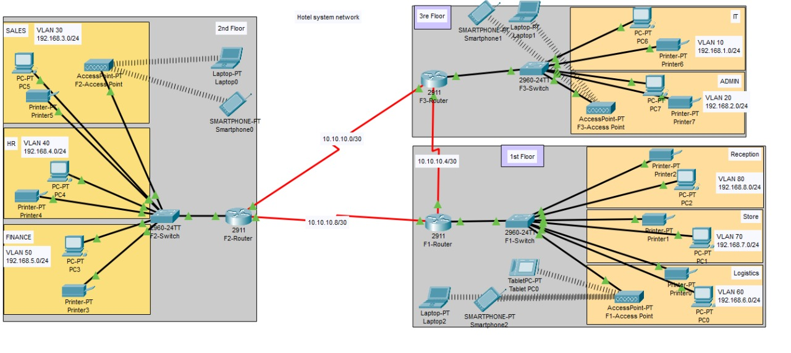
Network Diagram
Routers
Here we are using 3 Routers in every floor to enhance our network connectivity.
Each Routers connected each other with serial DCE cables
Access Point
V LAN Switches
The help of V-LAN switch We can segment our networks .It will more helpful to reduce the cost of buying more separate switches
We are access point in every floor to connect wireless devices
We are connected Departments using a single switch by configuring switch into VLAN Switch

Slide 9
Network Setup
To Demonstrate our Project design and idea we have used CISCO Packet Tracer Software
As per the Project here we use one Pc and 1 Printer for each Department. Every department in floors connected with switches
Each switch connected with Router, Every Router Represent the floor. We have to give the fastest broadband service into the router
Here we connect access point with the switch and it provide free internet for our clients

Slide 10
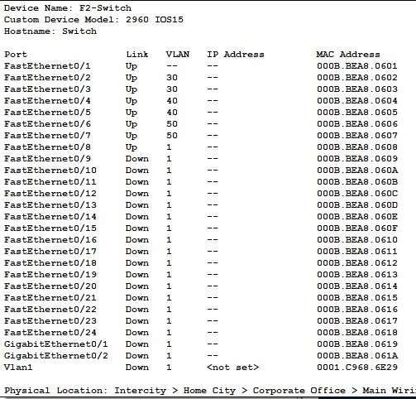
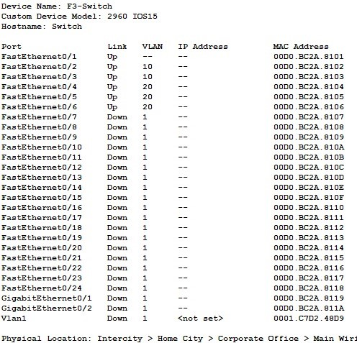
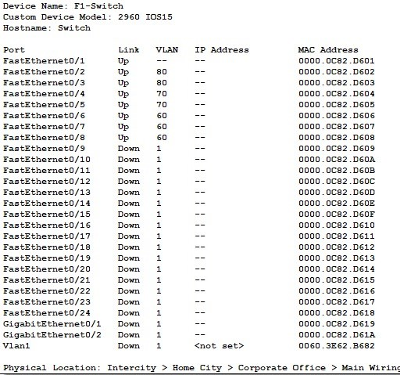
Network Setup VLAN
Configuring VLAN for Departments
Configuring VLAN for Department PCs
A VLAN (virtual LAN) is a subnetwork which can group together collections of devices on separate physical local area networks (LANs).
To avoid one guest from accessing another guest’s PC or the Staff PC’s we have assigned each PC with different VLAN. Same applies for Staff PCs too.
Advantage of VLAN is that it can allow different PCs having same VLAN value to connect to each other. So we can have different groups of PC that can have intra connectivity but not inter.
For example we can group all PCs of accounts department under one VLAN so that only accounts staff can access each other. Others won’t be able to access Account Department’s PC.

Slide 11
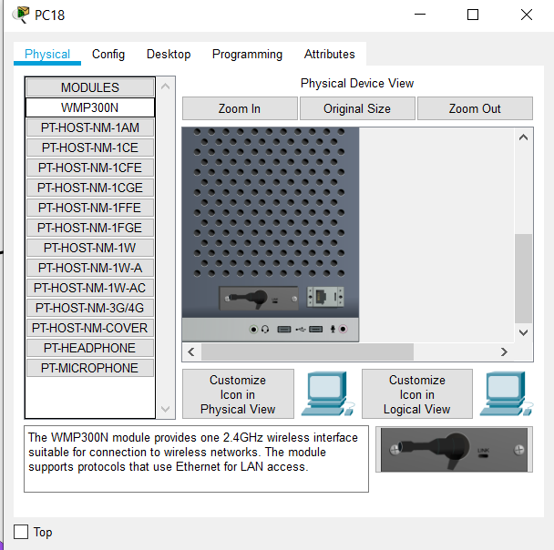
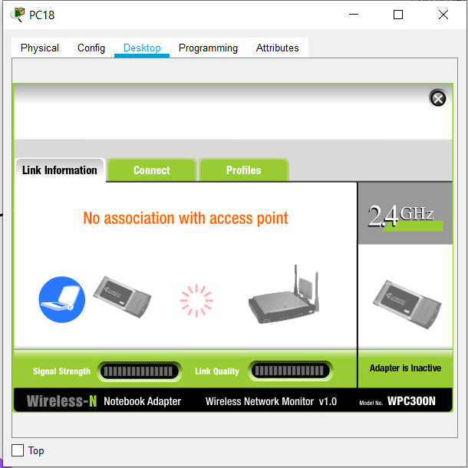
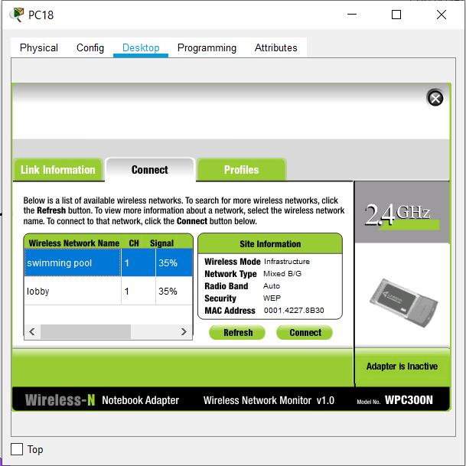
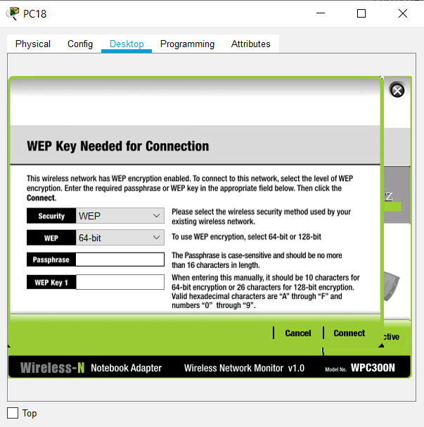
Network Setup
Wi-Fi
We have setup Wi - Fi for every floor with password protection.
Here, we are testing the Wi - Fi by bringing in a new PC and connecting it with the Wi - Fi.
As we can see in the 4th image that both of the Wi - Fi are discoverable which shows that both of them are functioning properly.
When the user selects the required Wi - Fi and taps connect, he/she is asked to provide password for the Wi - Fi in the 4th image.
On providing the correct password the PC get connected which we can see in the last image.
Setting up Wi - Fi

Slide 12
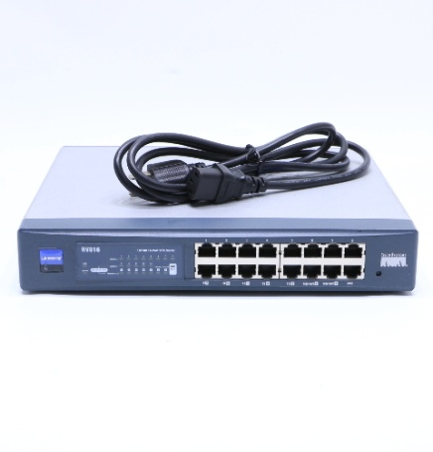
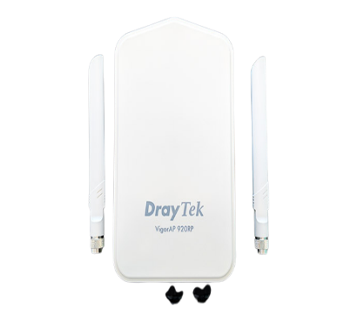
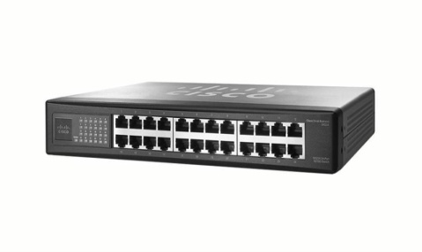
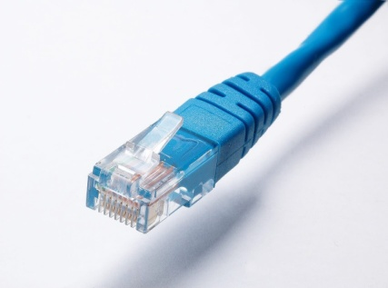
Recommended Products
 | Your Text
 | x3
 | x3
 | x3
 | As per Hotel’s Dimension
CISCO LINKSYS RV016
16 - PORT 10/100 ROUTER
CISCO SF - 100 SR224T
24 – PORT 10/100 SWITCH
DRAY TEK-VIGOR AP 920 RP
High Power Smart Repeater
MEDIABRIDGE FBA 31-299-100B
Highly Durable Ethernet Cable

Slide 13
THANK YOU

